Slide 1

Project Title -Optimizing Profitability in Retail: An In-Depth Sales and Profit Analysis
Student Name-ACHHUTA NAND JHA
College Name-GLA University​
Department-Department of Computer Engineering & Applications
AICTE Internship Student Registration ID) : STU662a2083d78941714036867
​

Slide 2

PROBLEM STATEMENT
Analyze retail sales data to uncover patterns and insights, identifying key factors that impact sales and profitability across regions, customer segments, and product categories to inform data-driven strategic decisions.

Slide 3
Project Description
This project focuses on a comprehensive analysis of retail sales data to extract valuable insights into sales performance and profitability. Utilizing Python's data analysis libraries (Pandas, NumPy) and visualization tools (Matplotlib, Seaborn), we aimed to identify key trends and relationships among various features, including product categories, discounts, quantities sold, and shipping modes.​

Slide 4
Project Description
By exploring the dataset, we analyzed how factors like customer segments and regional variations influence sales and profits. The analysis involved data cleaning, feature engineering, and visualization of results through various charts and graphs. Key objectives included understanding the effectiveness of discount strategies, identifying high-performing products, and providing actionable insights for optimizing inventory and marketing strategies to enhance overall business performance.

Slide 5

WHO ARE THE END USERS?
Business Analysts – To gain insights into sales patterns and identify areas of potential growth.
Retail Managers – For making informed decisions on inventory management, pricing, and promotions.
Sales & Marketing Teams – To identify product trends and regions for targeted marketing efforts.
Data Science Teams – To further explore predictive analytics for future sales forecasts and trend analysis.

Slide 6

Technology Used
Technology Stack:
Programming Language: Python
Data Analysis Libraries: Pandas, NumPy
Visualization Tools: Matplotlib, Seaborn
Other Tools: Colab Notebook for data exploration and visualization
Data Processing Techniques:
Data cleaning and preprocessing.
Feature engineering for enhanced insights.

Slide 7
RESULTS
Visualizations
Sample Visualizations:
Scatter plot of Quantity vs Profit.
Bar charts of Sales and Profit by Ship Mode, Segment, and Region.
Heatmap of Profit Margin by Category and Sub-Category.
Clustered bar chart of Sales, Profit, and Quantity by Region and Category.

Slide 8
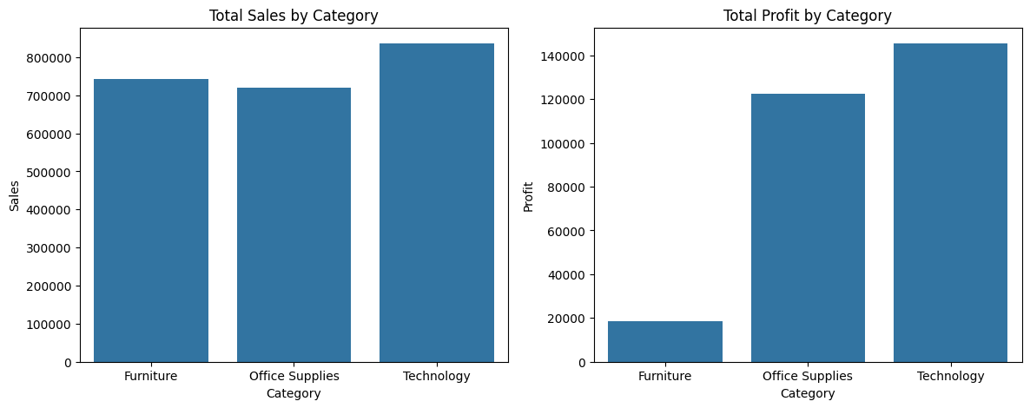
RESULTS

Slide 9
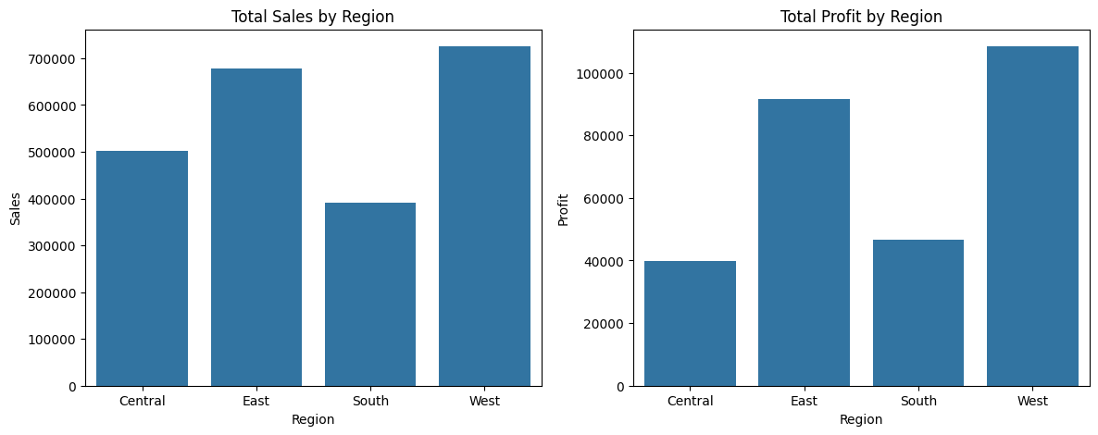
RESULTS

Slide 10
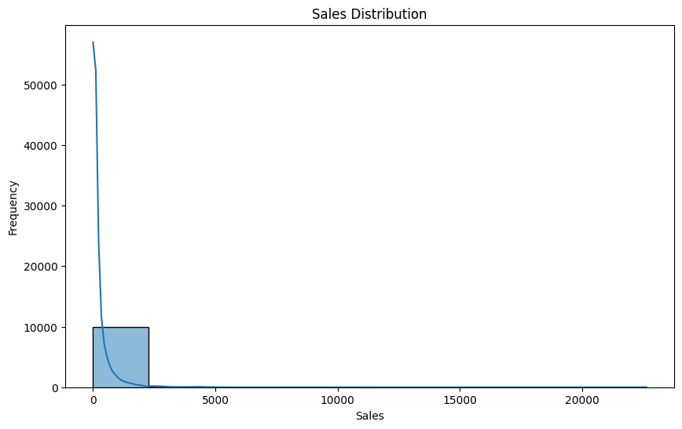
RESULTS

Slide 11
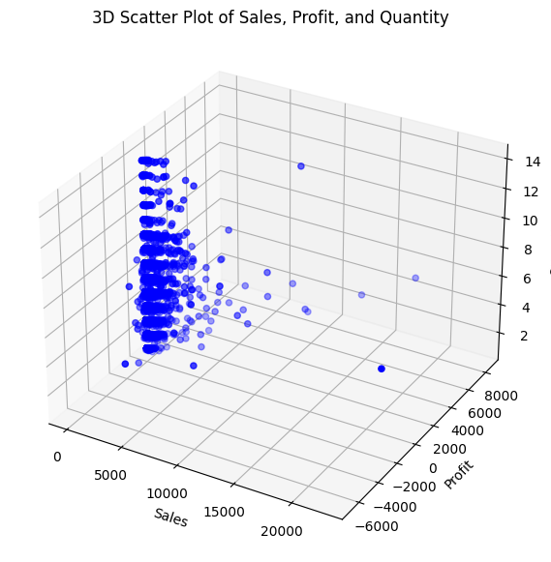
RESULTS

Slide 12
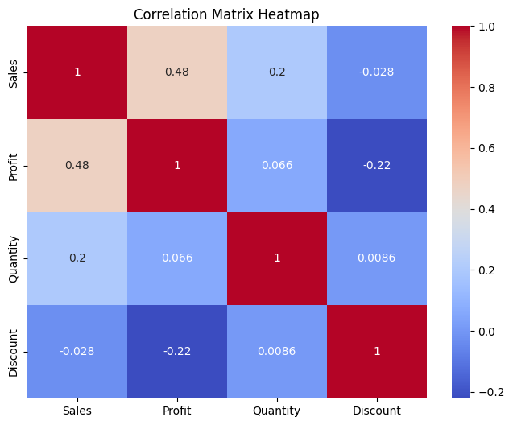
RESULTS

Slide 13
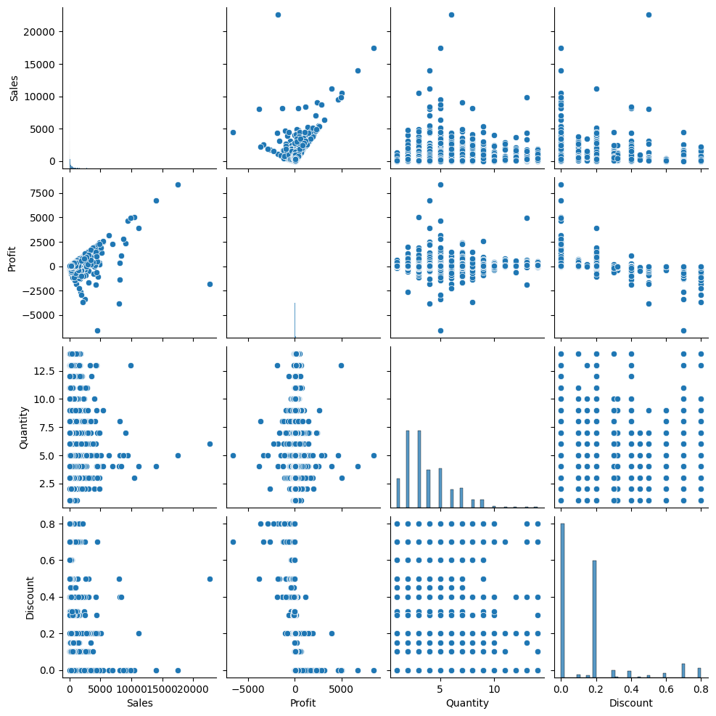
RESULTS

Slide 14
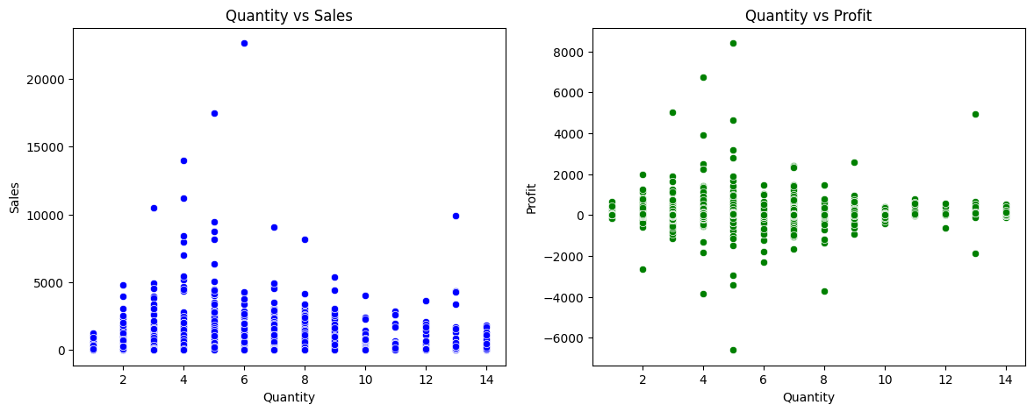
RESULTS

Slide 15
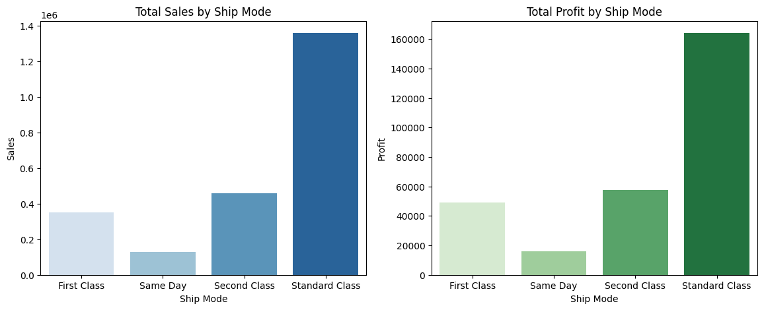
RESULTS

Slide 16
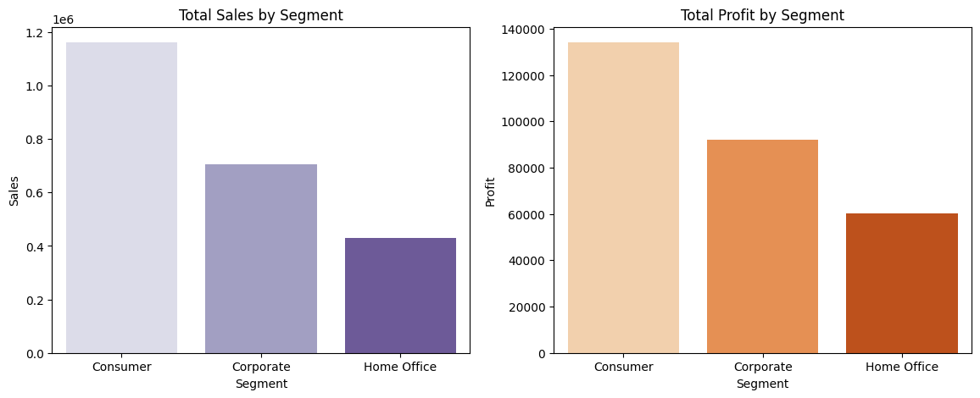
RESULTS

Slide 17
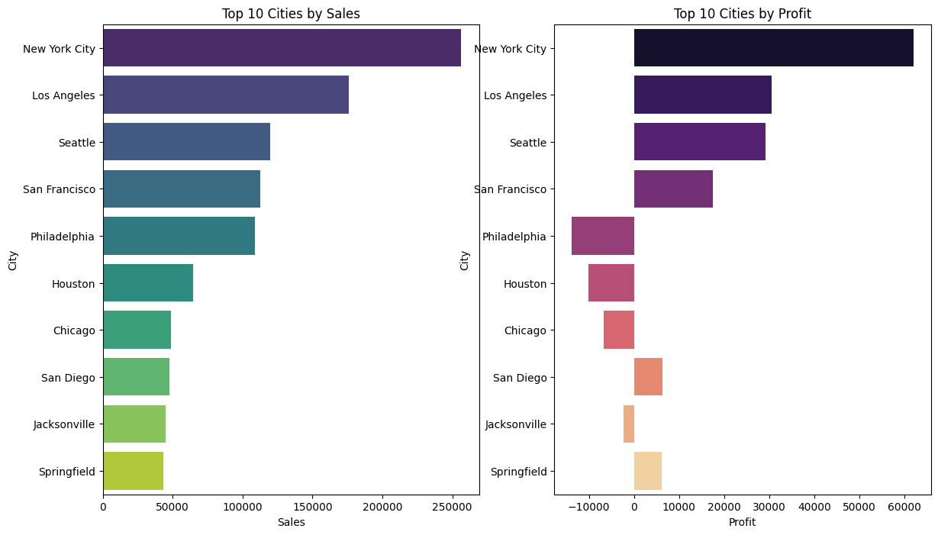
RESULTS

Slide 18
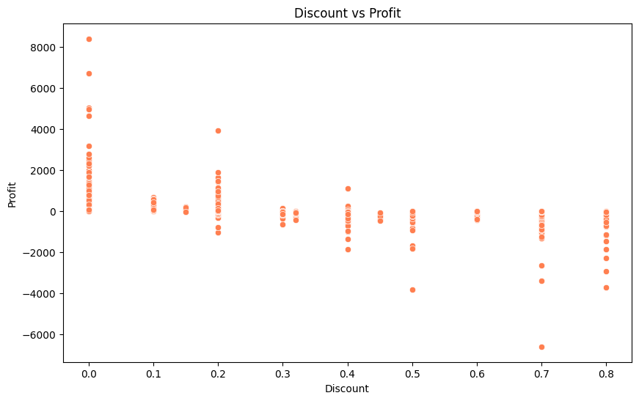
RESULTS

Slide 19
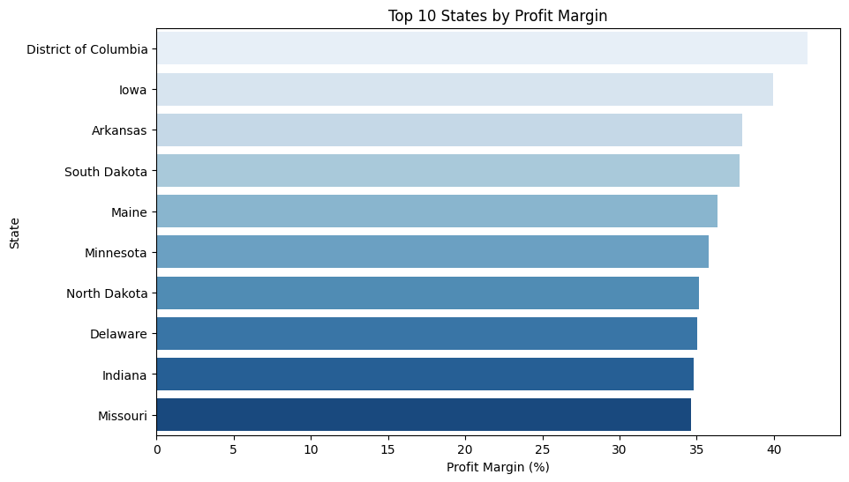
RESULTS

Slide 20
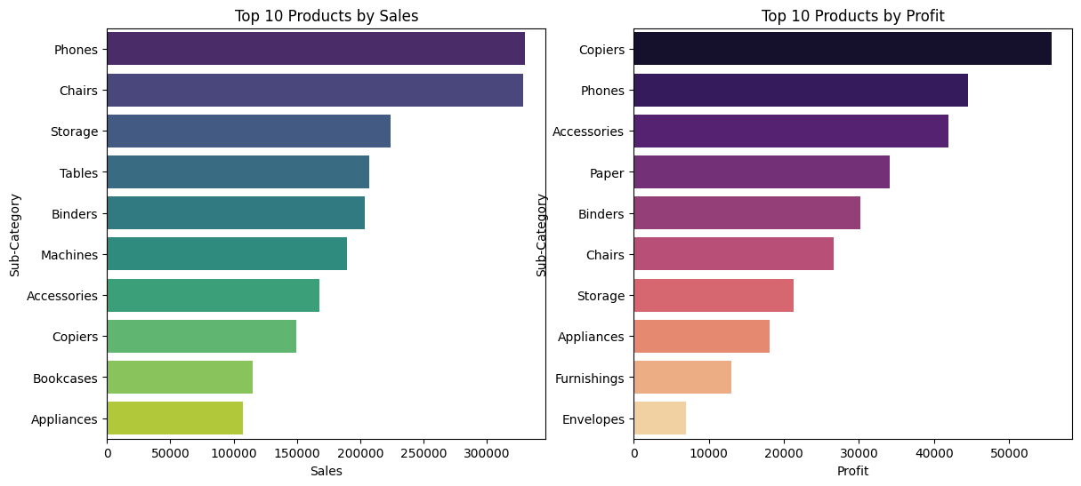
RESULTS

Slide 21
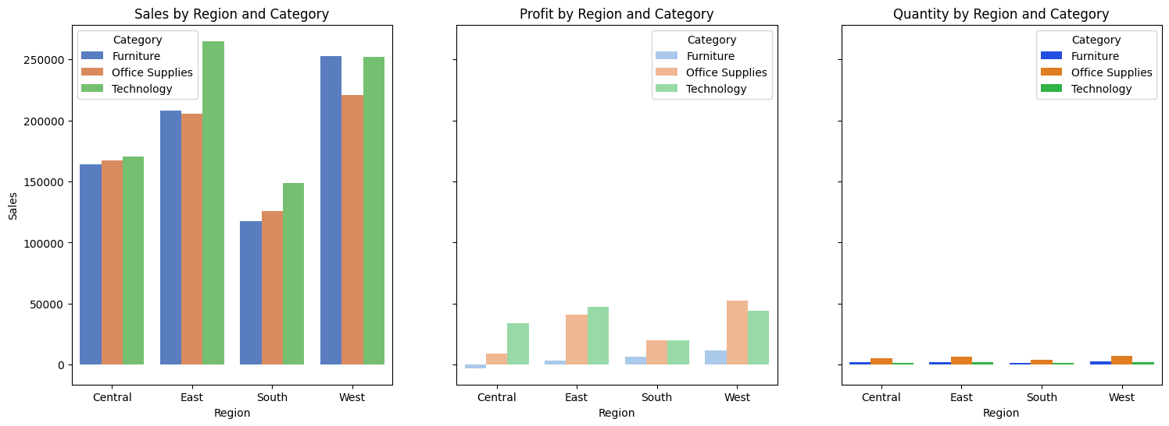
RESULTS

Slide 22
RESULTS
Results and Key Insights:
Quantity and Profit Relationship: Identified the optimal quantity range for maximizing profits.
Impact of Discounts: Discovered that high discounts negatively impact profit margins.
Top Performing Products and Categories: Visualized which product categories and sub-categories generate the most sales and profit.
Sales by Segment and Region: Found that certain regions and customer segments significantly impact total sales.

Slide 23
RESULTS
onclusion and Next Steps
Conclusion:
This analysis provides actionable insights for retail companies to improve sales strategies and maximize profitability.
Understanding the relationships among various features can aid in decision-making processes, helping businesses focus on profitable segments and optimal discount strategies.
Next Steps:
Implement predictive modeling to forecast sales.
Further analyze seasonal trends if additional time-based data is available.
Consider recommendations based on insights for inventory management, marketing, and strategic planning.
Demo Link

Slide 24
Thank you for your attention
.
.

